Slide 1
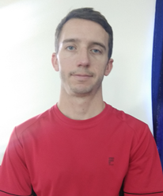




Shira Clamp for Microvascular Surgery
Patrick Phelon, Engineering Management Graduate student at UMass Amherst,USA
Ruike Zhang, Human Resources Management Graduate student at Nanjing University, China
Hannah Bagley, Junior Biomedical Engineering student at UMass Lowell, USA
Vaishakh Kuppast, Electronics and Communication Engineering UG in KLE Technological University, India
Manoj Madnur, Mechanical
Engineering UG in KLE Technological
University, India
Global Entrepreneurship and Innovation
India 2019

Slide 2
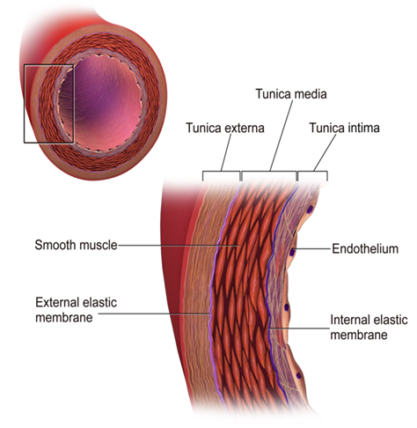
The Problem
Surgeons in India with limited training have difficulty performing anastomosis
Gangrene Amputation
Time consuming
Tissue Damage
Ends of blood vessels can slip easily
Is this a problem?
Amputation in 28% of patients is due to failed revascularization (1)
5-6% of anastomosis lead to gangrene and subsequently amputation
-Dr. K.G. Byakodi
https://ac.els-cdn.com/S074152141500155X/1-s2.0-S074152141500155X-main.pdf?_tid=63a4ae1d-e8ff-47a6-886e-01c2e8a7c784&acdnat=1546850551_7cdb49b3ccc267953ad93ca349d14b68

Slide 3

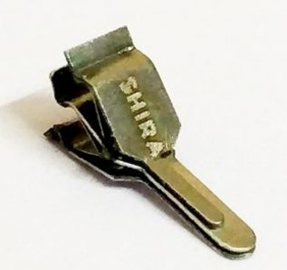
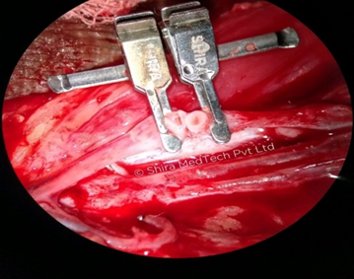
Shira Clamps
A clamp used for micro vascular surgery.
Thumbnail-sized device.
Open and visible ends of blood vessels
Durable, adjustable to accommodate various different surgeries.
Key Values-
Less training required
Reduces rate of amputations
Reduce waste through reusable
product

Slide 4
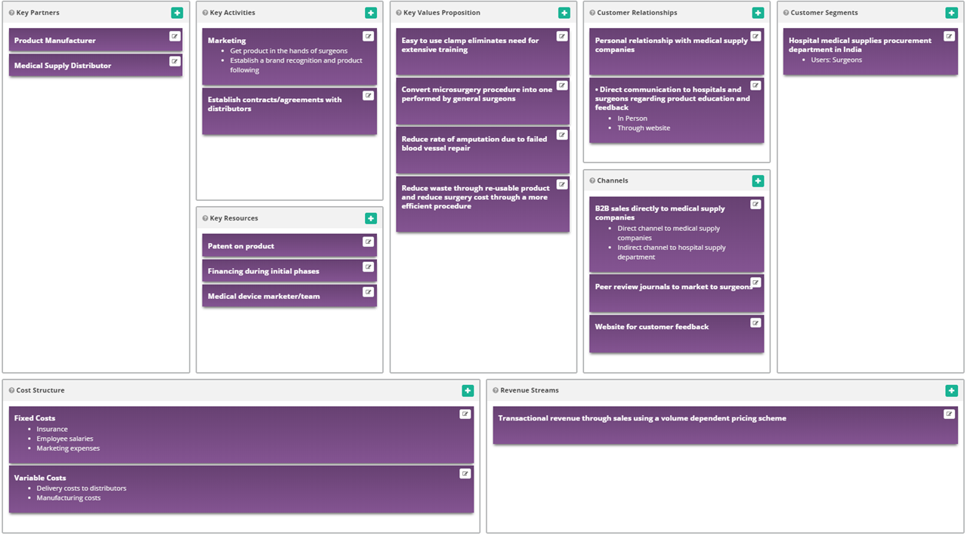
Business Model Canvas

Slide 5
Opportunity and Target Market
Our Target Market is Hospital medical supplies procurement departments
Primary Research
Secondary Research
Typical microvascular surgery takes ~30-45 minutes
1-2 mm blood vessels repaired under microscope during digit implementation(fingers/toes).
If the blood vessel is not repaired in time, it develops gangrene, causes amputation
The Clamps usage improves the efficiency of vascular repair, and reduces the amputation rate and mortality rate
Leading cause of amputation in India is due to Trauma
Time is an issue, therefore a tool is required for general surgeon use
In 2015,31 million clamp products were consumed, up 54% year on year; 43 million clamp products were consumed in 2016

Slide 6
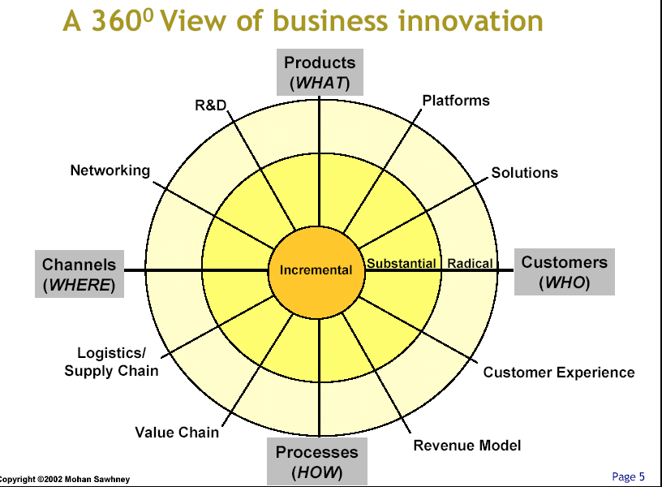
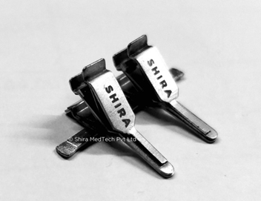
Our Solution vs Other Solutions
Identify key attributes
Certain feature
---Two clamps
---Reusable
Price---8,900-14,600 rupees
Competitive Radar
Fixation of blood vessels facilitates doctor's operation
Save the time of repairing blood vessel
Improve the rate of repairing blood vessel
Reduce the incidence of consequences
Prevent others copying---Patent

Slide 7
Conclusions
There is a pain that can be relieved
Profit potential exists in the industry
Shira has the potential to create a desirable value proposition
Recommendations
Distribute through medical supply company rather than direct sales through website
Target marketing both to surgeons and to hospital supply procurement department by appealing to business benefits
Reusability, surgery time reduction, decrease number of post-op complications
Incorporate an easy to use feedback/customer portal for surgeons to communicate back to company
Establish a brand recognition by getting the product in the hands of surgeons
Potential future product improvement would be to reduce trauma induced by clamping mechanism

Slide 8
References
https://www.sciencedirect.com/science/article/pii/S1013702512000474
https://ac.els-cdn.com/S074152141500155X/1-s2.0-S074152141500155X-main.pdf?_tid=63a4ae1d-e8ff-47a6-886e-01c2e8a7c784&acdnat=1546850551_7cdb49b3ccc267953ad93ca349d14b68
https://www.sciencedirect.com/science/article/pii/S0020138304002475
https://www.ncbi.nlm.nih.gov/pmc/articles/PMC4727477/
https://shiramedtech.com/

